Slide 1
Vision Computing Experiment 1
Image Fundamentation
March 23, 2021

Slide 2
Introduction
Image matrix
Color Mode
Bit image
Convolution

Slide 3
Image Matrix
Task 1：Output a 16x16 random image

Slide 4
Image Matrix
R = rand(N)
Get a random matrix
imshow(Image)
Show an image

Slide 5
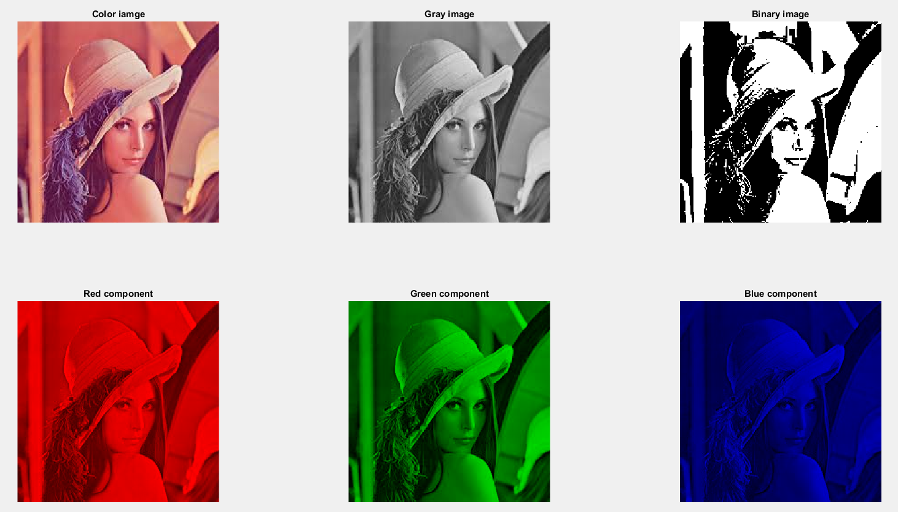
Color Mode
Task 2: [use lena_color.jpg]
Input a color image
Converse to gray and binary version, show them
Show the its red, green, blue componet

Slide 6
Color Mode
I=imread(filename)
Read image
imshow(I)
Show image
G=rgb2gray(I)
Converse a color image to gray image
G=im2double(I);
Converse a image from uint8(0~255) to double(0~1)

Slide 7
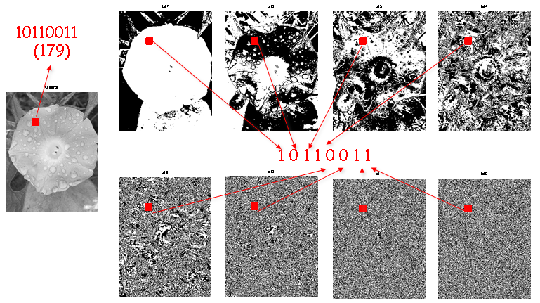

Bit plane of Image
Task 3: [use flower.jpg]
Input an gray image, output its bit planes
Bit plane $f_{i}=F AND 2^{i}$

Slide 8
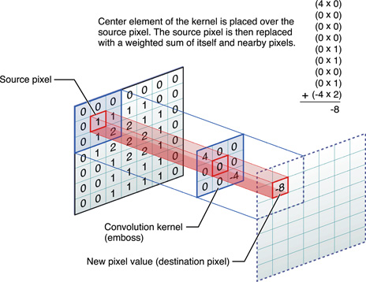
Convolution
Image filter and convolution

Slide 9
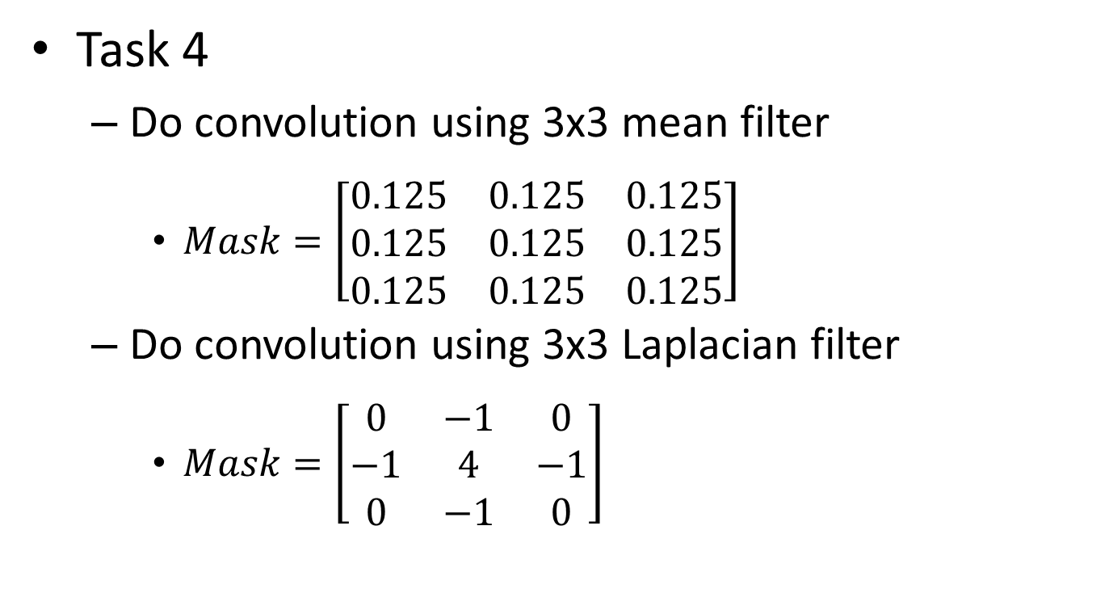
Convolution
Task 4
Do convolution using 3x3 mean filter
$Mask=\left[\begin{matrix}0.125 & 0.125 & 0.125 \\ 0.125 & 0.125 & 0.125 \\ 0.125 & 0.125 & 0.125\end{matrix}\right]$
Do convolution using 3x3 Laplacian filter
$Mask=\left[\begin{matrix}0 & −1 & 0 \\ −1 & 4 & −1 \\ 0 & −1 & 0\end{matrix}\right]$

Slide 10
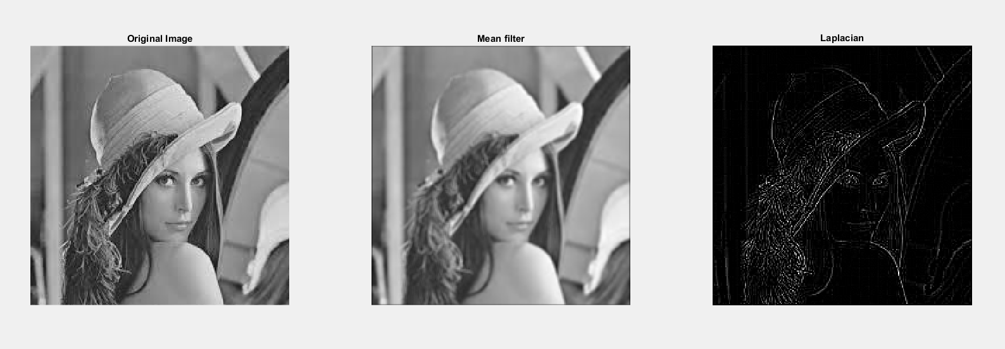
Convolution
Task 4 [use lena.jpg]

Slide 11
Convolution
B = imfilter(A,H)
Do a convolution of mask H on A
H = fspecial(TYPE)
Get the filter operator(mask)
This function is not necessary as you can write the mask yourself

Slide 12
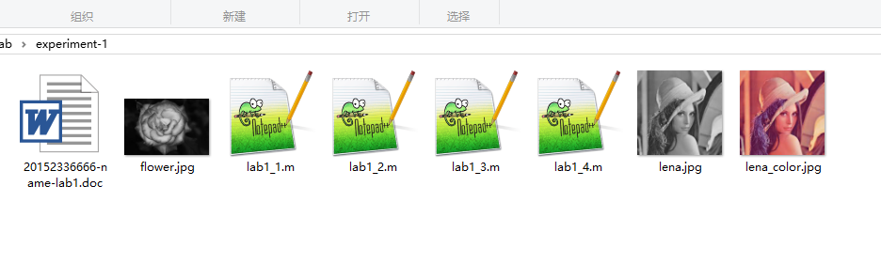
You are required to hand in your code and report
Name your file in this format
Package them and it name as ‘studentID-lab1.rar’
Monitor should collect them and package, name it as ‘class-lab1.rar’
Send to mike_1997@126.com

Slide 13
If you are not familiar with matlab, you can refer to ‘introduction to Matlab.pptx’
All these file can be download
https://pan.baidu.com/s/1Ru5NnM9GRCUazlalmHsi9w
Password: m3ge [ Computer Vision/lab1.rar]

Slide 14
If you are not familiar with matlab, you can refer to ‘introduction to Matlab.pptx’
All these file can be download
http://pan.baidu.com/s/1bcnGMa
Password: 43sa [ computer vision/lab1.rar]

